Slide 1
Warm Up
Make a list of what you know about compounds.

Slide 2
Bonding
SPS1b. Compare and contrast ionic and covalent bonds in terms of electron movement.

Slide 3
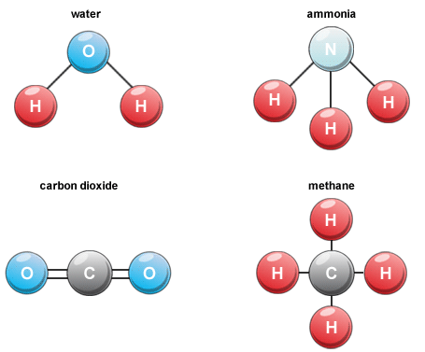
Componds
Definition: Pure substance made of two or more different elements and can be separated into smaller substances by chemical means. Atoms form compounds to become more stable.
Examples: H₂O,
CO₂, CO, NaCl,
AlCl₃, MgO, Li₂O

Slide 4
Complete Octet
This is what all atoms want in order to become stable. This is the condition when there are 8 electrons in the outside energy level.
Example
Na 2)8)1
Lose 1e⁻
Na 2)8

Slide 5
Chemical Formula
Definition: The formula of compound describes the atoms in the compound and the ratio of the atoms in the compound.
Example
H₂O
Two atoms of H combined with 1 atom of O

Slide 6
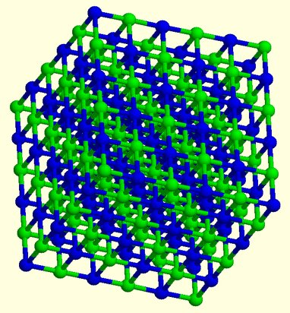
Ionic Compounds
Definition: Transfer of electrons between a metal and nonmetal to form a full energy level (complete octet). Metals lose electrons and become positive, cations. Nonmetals gain electrons and become negative, anions.
Examples: NaCl, KCl, CaO, MgO, Al₂O₃, MgCl₂

Slide 7
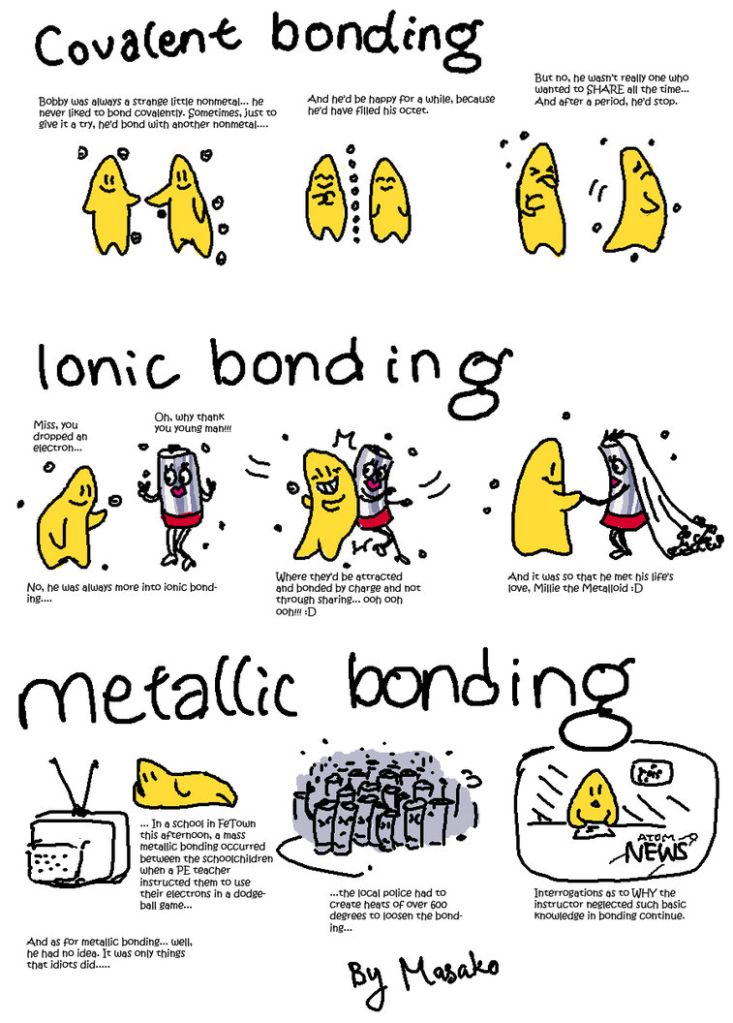

Slide 8
Covalent Compound
Atoms share electrons in order to become stable (complete octet). They are formed between nonmetals.
Examples
CO₂
CO
SO₂

Slide 10
Oxidation Number
The charge of an ion which is determined by the group an atom is in.
Examples
Group 1 = 1+
Group 2 = 2+
Groups 3-12 = Varies+
Group 13 = 3+
Group 14 =+/- 4
Group 15 = 3-
Group 16 = 2-
Group 17 = 1-
Group 18 = 0

Slide 11
Create a T-Chart for Ionic and Covalent
Ionic Bond | Covalent Bond

Slide 12
Ionic Bond | Covalent Bond
Makes “Compounds” Transfers (gives/takes) electrons to be noble Made with metals and nonmetals Positive (cation) and negative (anion) ions Weak bond Example: NaCl, KCl | Makes “Molecules” Shares electrons to be noble Made of nonmetals Neutral Strong bond Examples: H₂O, CO₂, NH₃, HCl, CH₄

Slide 13
Ionic & Covalent Bond Poster
With 1 partner, create a poster
Include at least 5 comparisons
  1 must talk about electrons
  DO NOT copy what I gave you at the beginning of class
Include 1 drawing on the Ionic side and 1 drawing on the covalent side
Ionic – p.159 Covalent – p.166
***Due by the end of class***

